Slide 1
RDBES Upper Hierarchies
24th September 2024
David Currie

Slide 2
Aims of the RDBES:
Make data available for the RCGs
Provide a regional estimation system for ICES stock assessments
To increase the data quality, documentation of data, and the use of approved methods
To facilitate the production of fisheries management advice and reports,
To increase the awareness of fisheries data collected and the overall usage of these data.
The RDBES should be seen as part of the movements towards:
Statistically Sound Sampling Schemes (4S),
Greater regional coordination
Transparent Assessment Framework (TAF),
Improved estimates to ICES stock assessments and advice.

Slide 3
RDBES Data Model
CL: Aggregated Commercial Landings
Data Model
CS: Detailed Commercial Samples
CE: Aggregated Commercial Effort

Slide 4
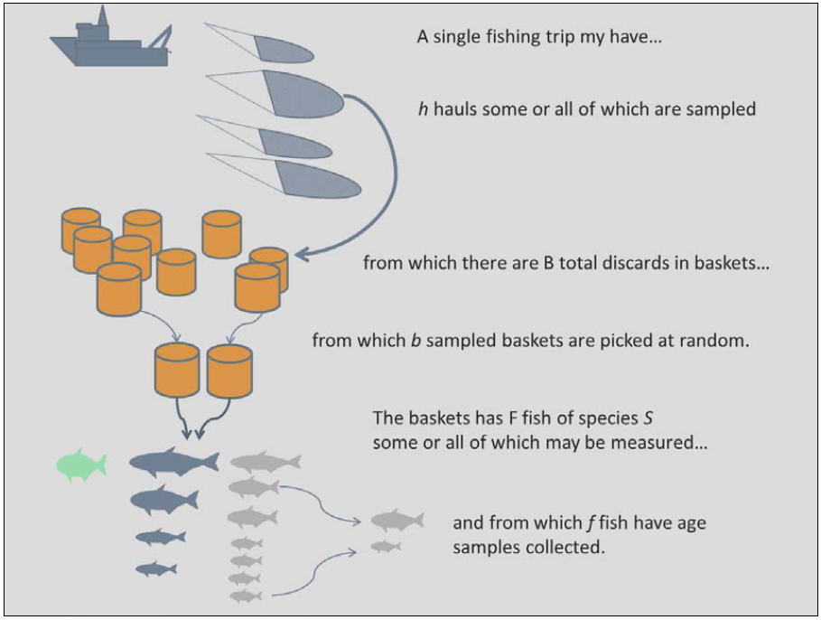
RDBES Data Model: CS
The RDBES Data Model is strongly based on the actual design of fisheries sampling programmes.
The designs used in the sampling of commercial fisheries in European waters are usually multi-stage.
In multi-stage designs the final sample (e.g., the fish sampled) is selected through a set of stages where the sampling units at each stage are sampled from the units chosen at the previous stage.
Some of the sampling stages will be stratified
Selection at each stage can be probabilistic (e.g. random) or non- probabilistic (e.g. expert judgement, quotas)
There is no single sampling design – different programmes use a variety of different designs
Other considerations including recording refusals and non-responses, and clustering
ICES. 2014. Report of the third Workshop on Practical Implementation of Statistical Sound Catch Sampling Programmes, 19-22 November 2013, ICES HQ, Copenhagen, Denmark. ICES CM2013/ACOM:54. 109 pp.

Slide 5
Important
The most important step in populating the RDBES data model is that you must first specify the design of your sampling programmes.
This is because, contrary to the RDB, there is not a single set of tables that everyone must populate and upload:
With a few exceptions, the tables that need to be populated and uploaded depend on the specific sampling design(s) each country used.

Slide 6
Definitions
To allow for the variety of sampling designs used in different institutes and countries the RDBES uses a slightly different approach to most database designs you might be used to.
Rather than specifying tables and the fixed relationships between them the RDBES identifies a number of different sampling hierarchies – these represent the different hierarchical sampling techniques that are used in practice.
Two types of hierarchy are used in the model –
the upper hierarchy describes how a sample is selected,
the lower hierarchy describes what type of length-frequency or biological variables are measured for that sample.

Slide 7
Definitions
The sampling hierarchies are defined in terms of the tables they consist of and the relationships between them.
All tables contain columns.
Some of these columns are described as design variables (DV) and represent important sampling concepts like stratification, population and sample size, inclusion probability or sampling method.
Tables will typically appear in a number of different hierarchies. There are two types of tables: hierarchy tables and auxiliary tables.
Hierarchy tables are those which contribute to the selection of a sample, whilst auxiliary tables contain data of interest which does not directly contribute to the sampling design.
In most hierarchy tables the rows represent individual selections made at that particular stage of the sampling hierarchy.

Slide 8
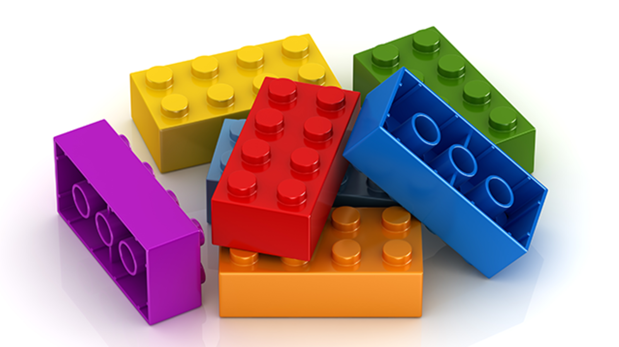
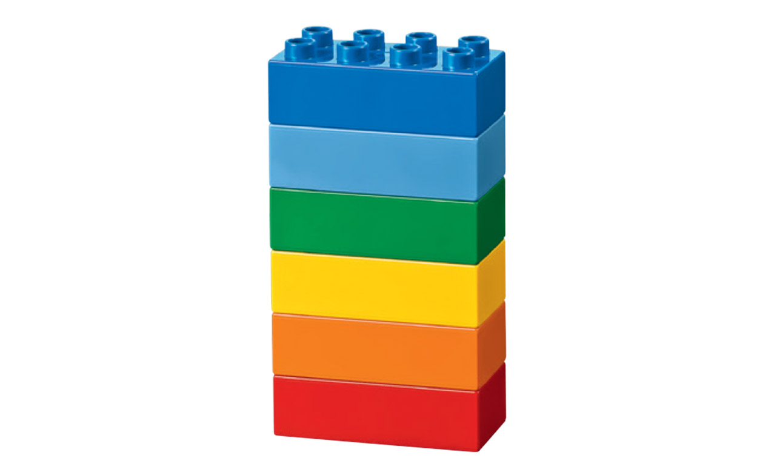
RDBES tables
RDBES hierarchies

Slide 9
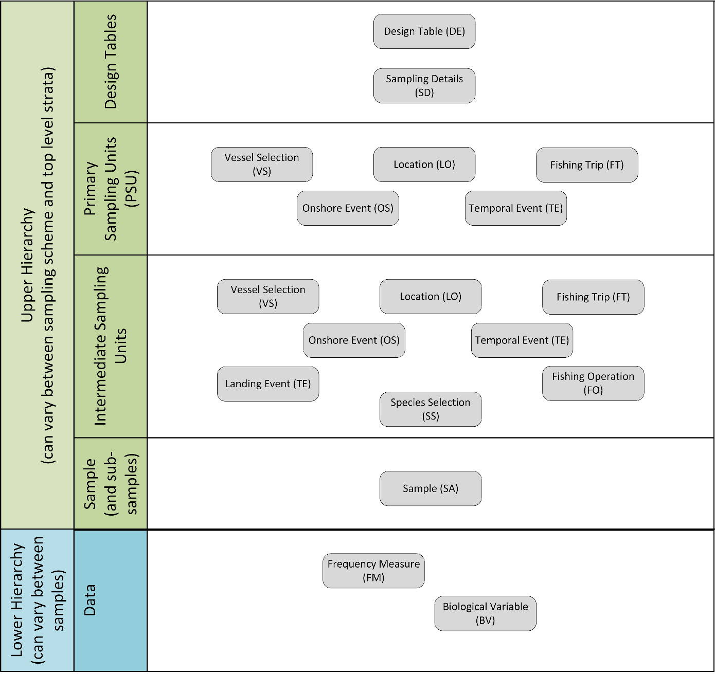

Slide 10
Table | Description
Design table (DE) | This table holds the information about the sampling scheme and stratification thereof. Further it specifies the upper hierarchy, which is unique for a given combination of sampling scheme and stratification.
Temporal Event (TE) | If one of the sampling units is some kind of time e.g., minute, week or quarter, then this is where to put the information about the selection.
Location (LO) | If one of the sampling units is a location, then this is where to put the information about the selection.
Vessel Selection (VS) | If one of the sampling units is a vessel, then this is where to put the information about the selection.
Fishing Trip (FT) | This table holds information about the fishing trip.
Fishing Operation (FO) | This table holds information about the fishing operation (either hauls/sets or trip level)
On-shore Event (OS) | If one of the sampling units is a combination of Location and Time, then this is where to put the information about the selection e.g. port-day
Landing Event (LE) | This table holds information about the landing event. Definition: Landings from a fishing trip or part thereof.
Species Selection (SS) | This table holds information about the selection of species expected in the Sample (SA) table e.g., only species from a national species list are sampled.
Sample (SA) | This table holds outcome of the sampling done in the upper hierarchy, i.e. the final sample of fish available for measurement or biological analyses.

Slide 11
Upper hierarchy auxiliary table | Description
Sampling details (SD) | This table holds information on the sampling country and institute.
Vessel details (VD) | This table holds information about the vessel properties e.g. homeport and vessel length
Species List Details (SL) | This table holds information about the list of species which are targeted during a sampling event.

Slide 12
RDBES tables
RDBES hierarchies

Slide 13
Hierarchy 1 | Hierarchy 2 | Hierarchy 3 | Hierarchy 4 | Hierarchy 5 | Hierarchy 6 | Hierarchy 7 | Hierarchy 8 | Hierarchy 9 | Hierarchy 10
Design | Design | Design | Design | Design | Design | Design | Design | Design | Design
Sampling Details | Sampling Details | Sampling Details | Sampling Details | Sampling Details | Sampling Details | Sampling details | Sampling details | Sampling details | Sampling details
Vessel Selection | Fishing Trip | Temporal Event | On-shore | On-shore | On-shore | On-shore | Temporal Event | Landing location | Vessel Selection
Fishing Trip | Fishing Operation | Vessel Selection | Fishing Trip | Landing Event | Fishing Trip | Species Selection | Vessel Selection | Temporal event | Temporal Event
Fishing Operation | Species Selection | Fishing Trip | Landing Event | Species Selection | Fishing Operation (a) | Landing Event (b) | Landing Event | Species selection | Fishing Trip
Species Selection | Sample | Fishing Operation | Species Selection | Sample | Species Selection | Sample | Species selection | Sample | Fishing Operation
Sample |  | Species Selection | Sample |  | Sample |  | Sample | Landing Event (b) | Species Selection
 |  | Sample |  |  |  |  |  |  | Sample
Hierarchy 11 | Hierarchy 12 | Hierarchy 13
Design | Design | Design
Sampling details | Sampling details | Sampling details
Location | Location | Fishing Operation
Temporal Event | Temporal Event | Species Selection
Fishing Trip | Landing Event | Sample
Landing Event | Species Selection
Species Selection | Sample
Sample

Slide 14
Note
Not all hierarchies have to be submitted – only those that correspond with how your data is collected
Both probabilistic and non-probabilistic sampling design data can be stored
Can have mix of probabilistic and non-probabilistic selection stages within the same hierarchy
Different upper hierarchies have been designed to store information from different sampling scheme designs
For example, Hierarchy 1 has been seen to be a common pattern used for at-sea sampling whilst on-shore sampling has more diversity

Slide 15
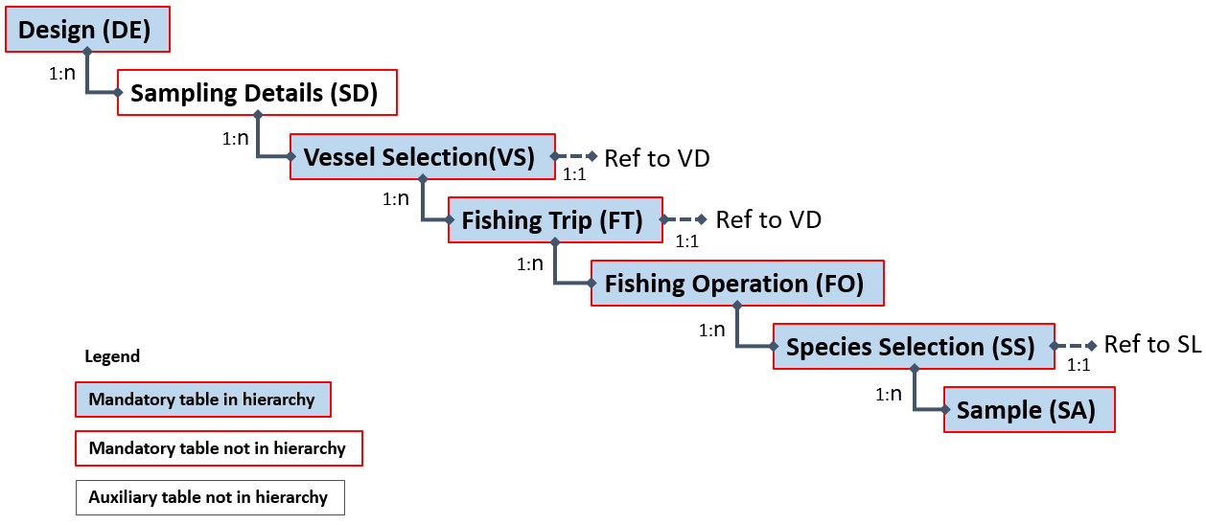
Example: Hierarchy 1 At-sea sampling from a vessel list or from a reference fleet
Upper hierarchy tables:
Design (DE)
Vessel Selection (VS)
Fishing Trip (FT)
Fishing Operation (FO)
Species Selection (SS)
Sample (SA)
Auxiliary tables:
Sampling Details (SD) (mandatory)
Vessel Details (VD) (mandatory)
Species List Details (SL) (mandatory)

Slide 16
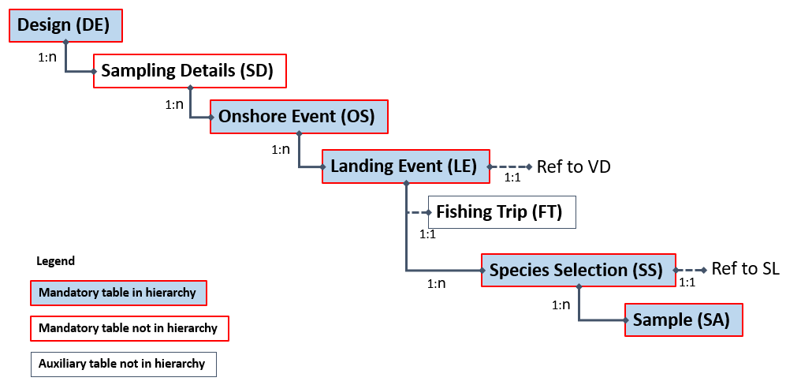
Example: Hierarchy 5 Sampling by selecting from location*time (e.g. harbour-day) as primary sampling unit, then from Landing Events as the secondary sampling unit.
Upper hierarchy tables:
Design (DE)
On-shore (OS)
Landing Event (LE)
Species Selection (SS)
Sample (SA)
Auxiliary tables:
Sampling Details (SD)
Vessel Details (VD) (mandatory)
Fishing Trip (FT) (optional)
Species List Details (SL) (mandatory)

Slide 17
Method
To populate the data model:
Identify the different sampling schemes you will use as the source data.
Ensure you understand how the sampling scheme is defined.
For each sampling scheme you have identified in point (1) identify which upper hierarchy is the best match
Extract your national data to populate the upper hierarchy tables.
Now identify which auxiliary tables you will be supplying data for and populate them.
For each sample you will need to decide which lower hierarchy you will be using – this describes whether the sample contains length-frequency data, biological measurements, or both.
The tables of the lower hierarchy can now be populated.
Data for each hierarchy have to be submitted in a separate data file, one for each hierarchy e.g. H2, H7, H8

Slide 18
Documentation is on GitHub
https://github.com/ices-tools-dev/RDBES/tree/master/Documents
“RDBES Documentation of the Data Model” – description of the RDBES data model and important concepts
“RDBES Data Model” spreadsheet specifies the main tables
“RDBES Data Model VD SL” specifies the Vessel Details, and Species List Details tables
“RDBES Data Model CL CE” specifies the Effort and Landings tables

